Slide 1
JESUS!
Lesson 5
Wise Men Visit
Purification at the Temple

Slide 2
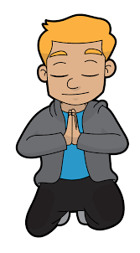
Prayer Requests
1
Class Prayer
Praise
Thanksgiving
Concern
Grow up to be like Jesus

Slide 3
Dedication at the Temple
2
Dedication

Slide 4
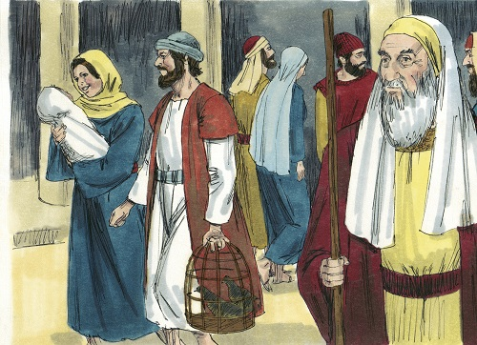
3
Luke 2:22-24
Jesus is presented to the Lord.

Slide 5
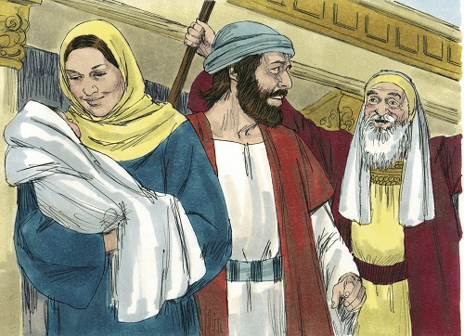
4
Luke 2:25-27
Simeon sees the Lord’s Christ.

Slide 6
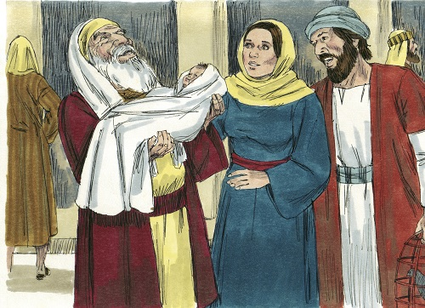
5
Luke 2:28-32
Simeon took him in his arms and praised God.

Slide 7
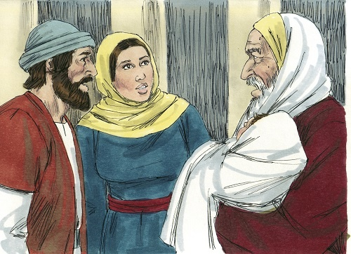
6
Luke 2:33-35
The child’s father and mother marveled at what was said about him.

Slide 8
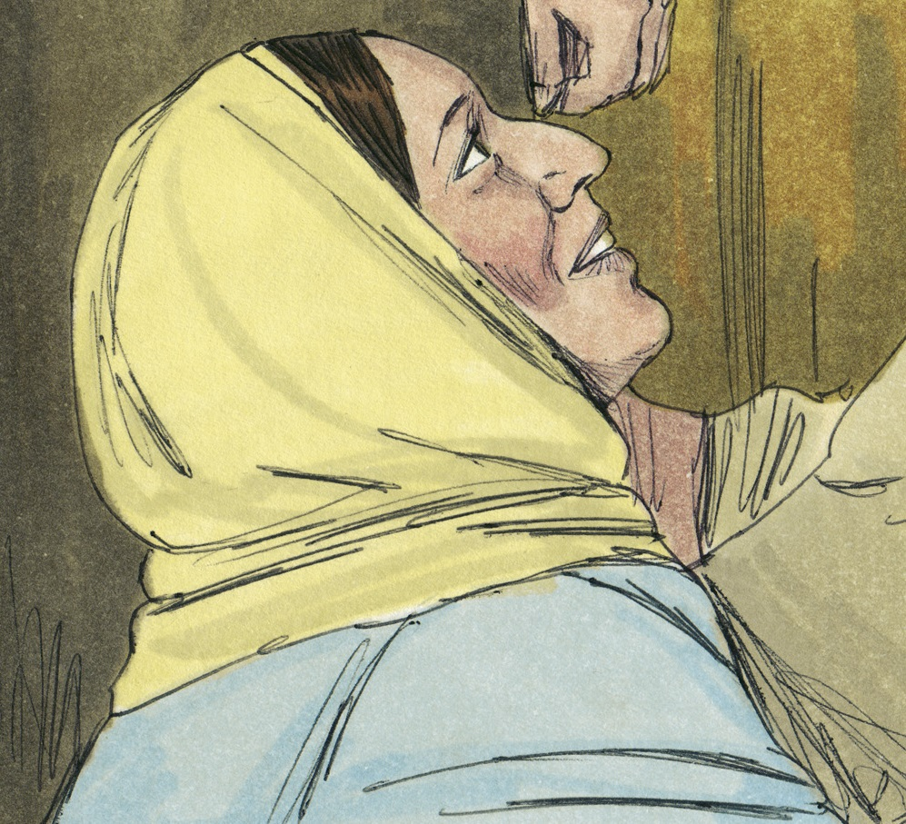
7
Luke 2:36-38
Anna gives thanks to God and spoke about looking forward to his coming.

Slide 9
Visit of the Magi
8
Visit of Magi

Slide 10
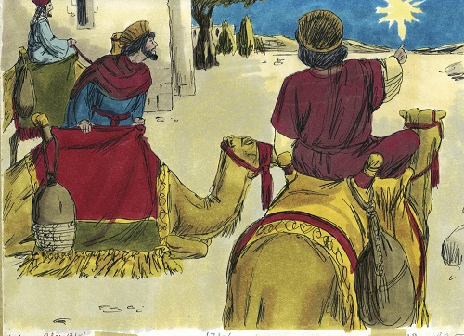
9
Matthew 2:1
After Jesus was born in Bethlehem, Magi from the east came to Jerusalem.

Slide 11
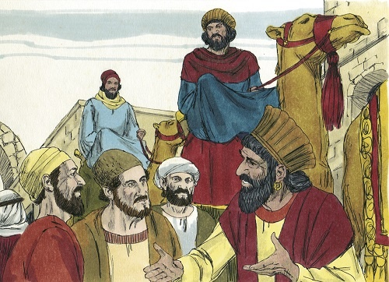
10
Matthew 2:2
“Where is the one who has been born king of the Jews? We saw his star in the east and have come to worship him.”

Slide 12
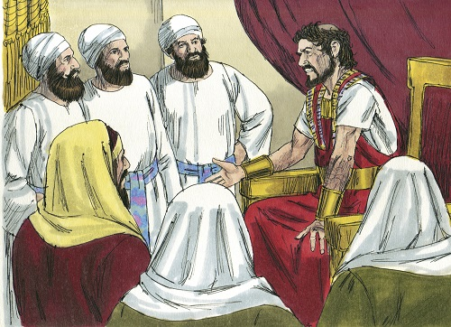
11
Matthew 2:3
When King Herod heard this, he was disturbed, and all Jerusalem with him.

Slide 13
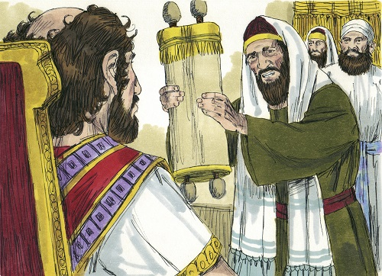
12
Matthew 2:4-6
Herod asked where the Christ was to be born. He was told it would be in Bethlehem.

Slide 14
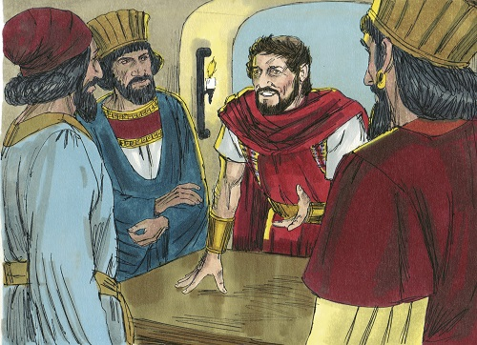
13
Matthew 2:7-8
Herod told the Magi to find the child and tell him when they did, so that he too could go and worship him.

Slide 15
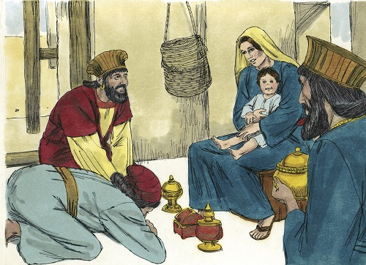
14
Matthew 2:9-11
When they found the child with his mother Mary, they bowed down and worshiped him.

Slide 16
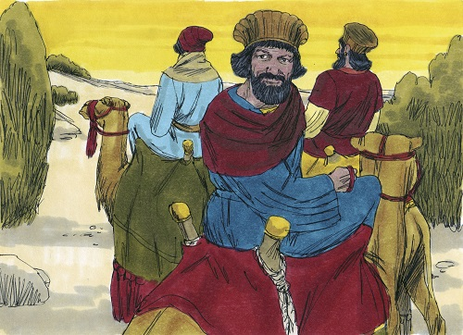
15
Matthew 2:12
After being warned, in a dream, not to go to Herod, the wise men returned to their country by another route.

